Slide 1
Project Report Template
✨

Slide 2
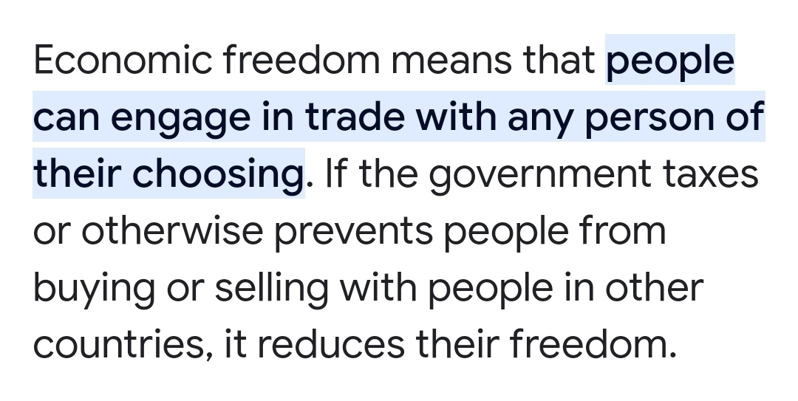
Overview of the project ✍️

Slide 3
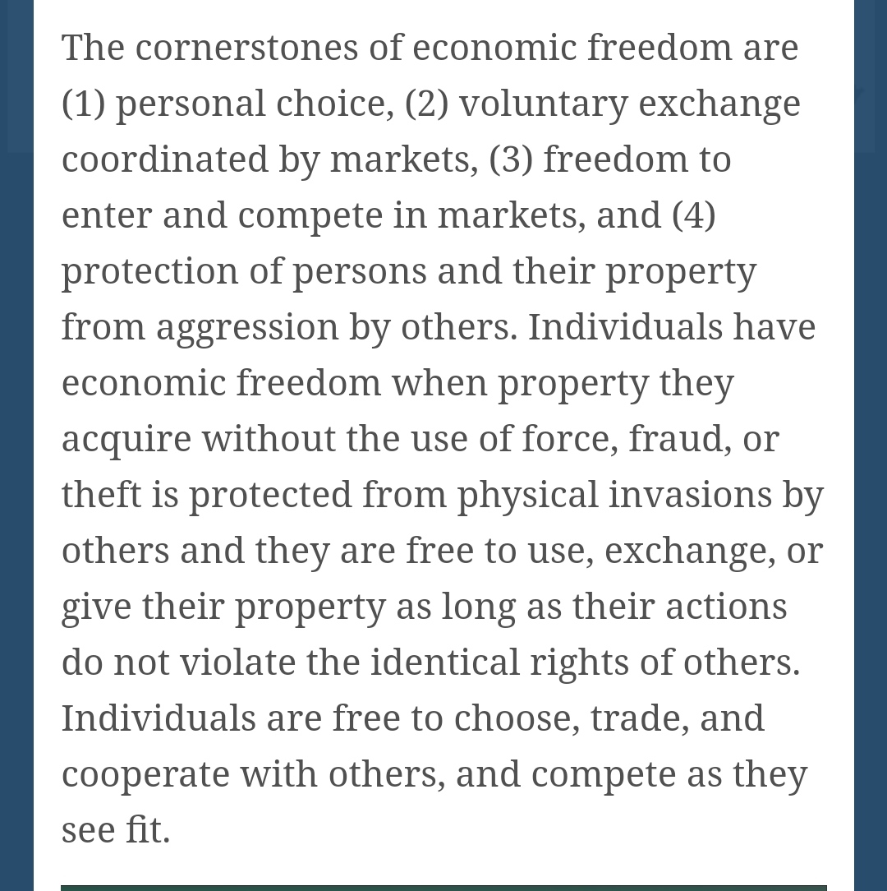
Purpose of the project

Slide 4
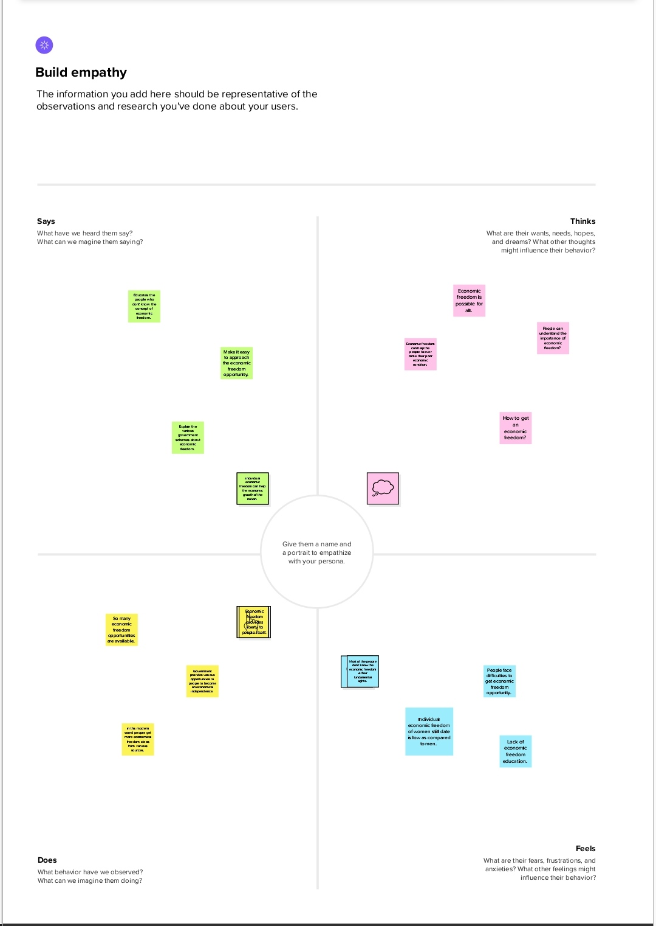
Empathy map

Slide 5
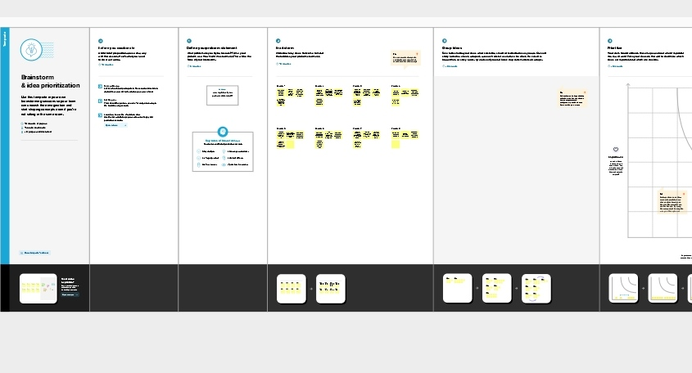
Ideation and brainstorming map

Slide 6
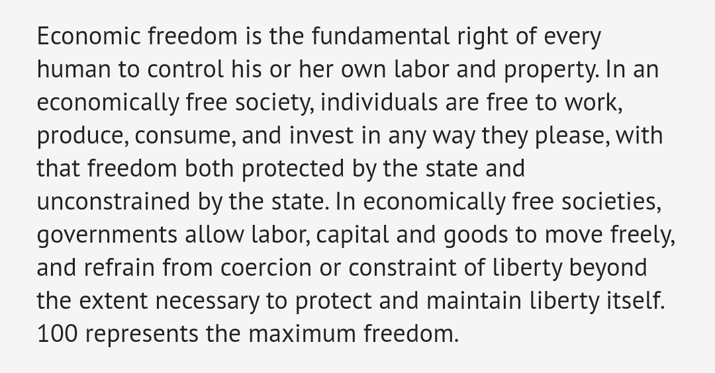
Result

Slide 7
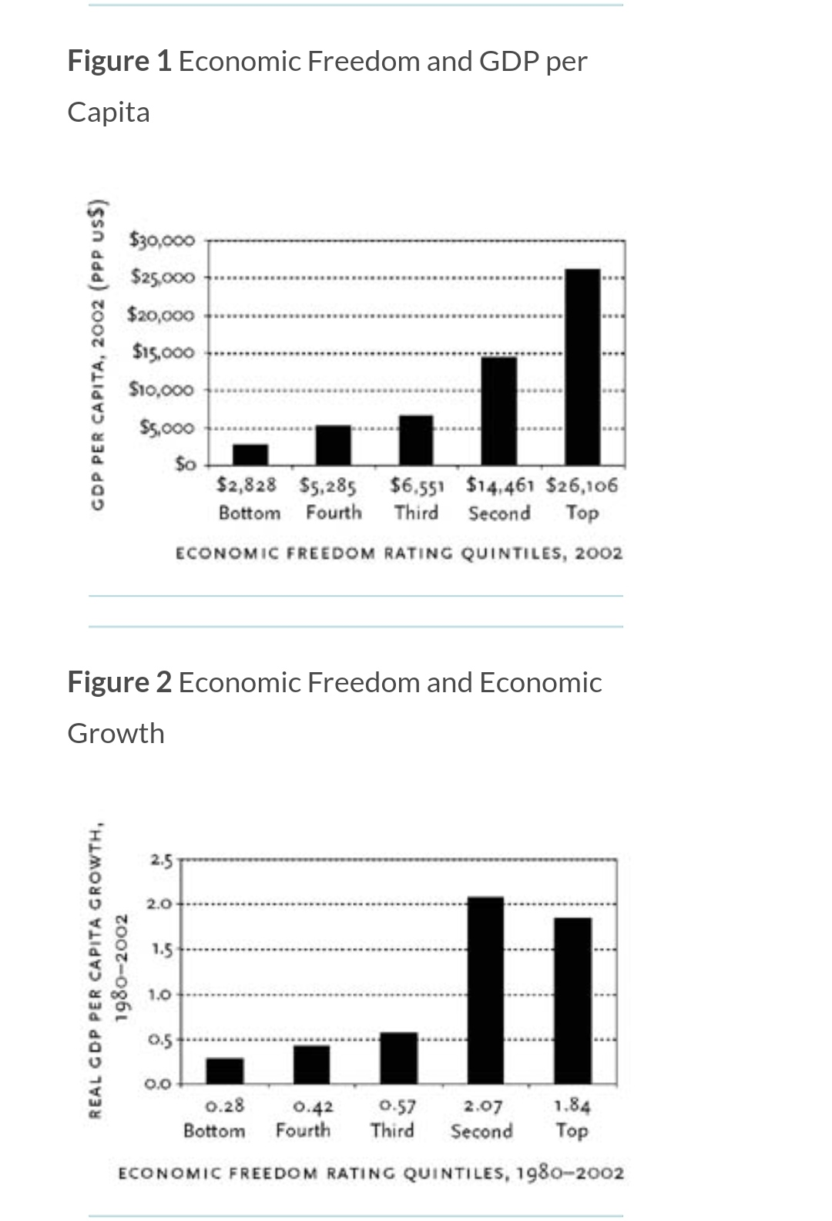
Results graphs

Slide 8
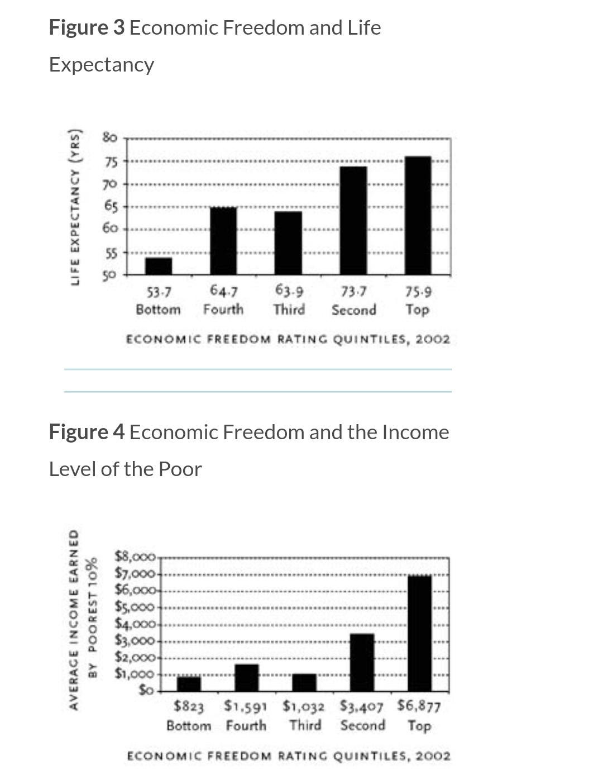
Results graphs

Slide 9
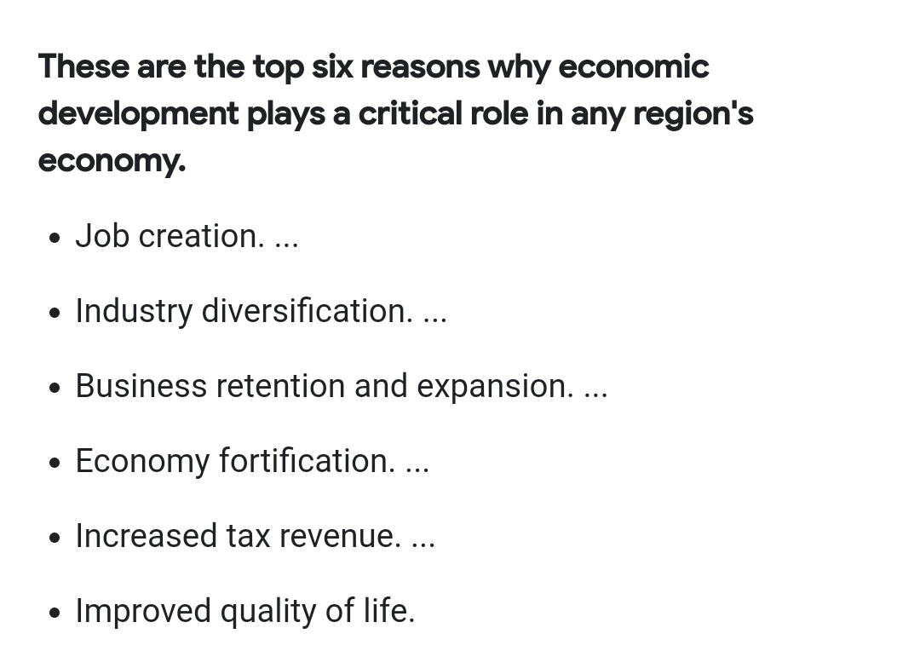
Advantages of Economic Freedom

Slide 10
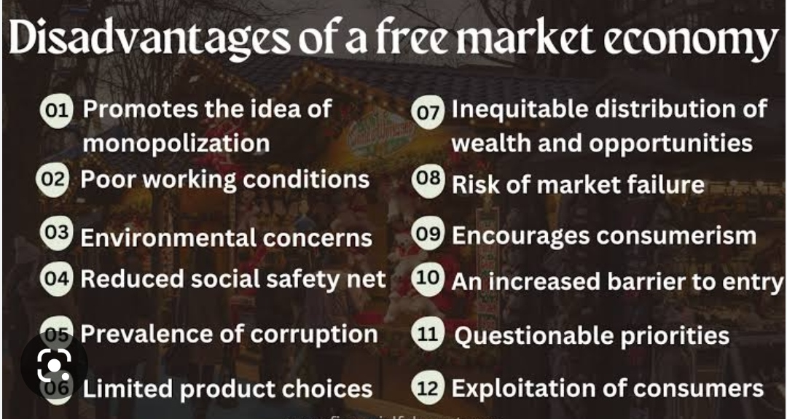
Disadvantages of Economic Freedom

Slide 11

Application of Economic freedom

Slide 12
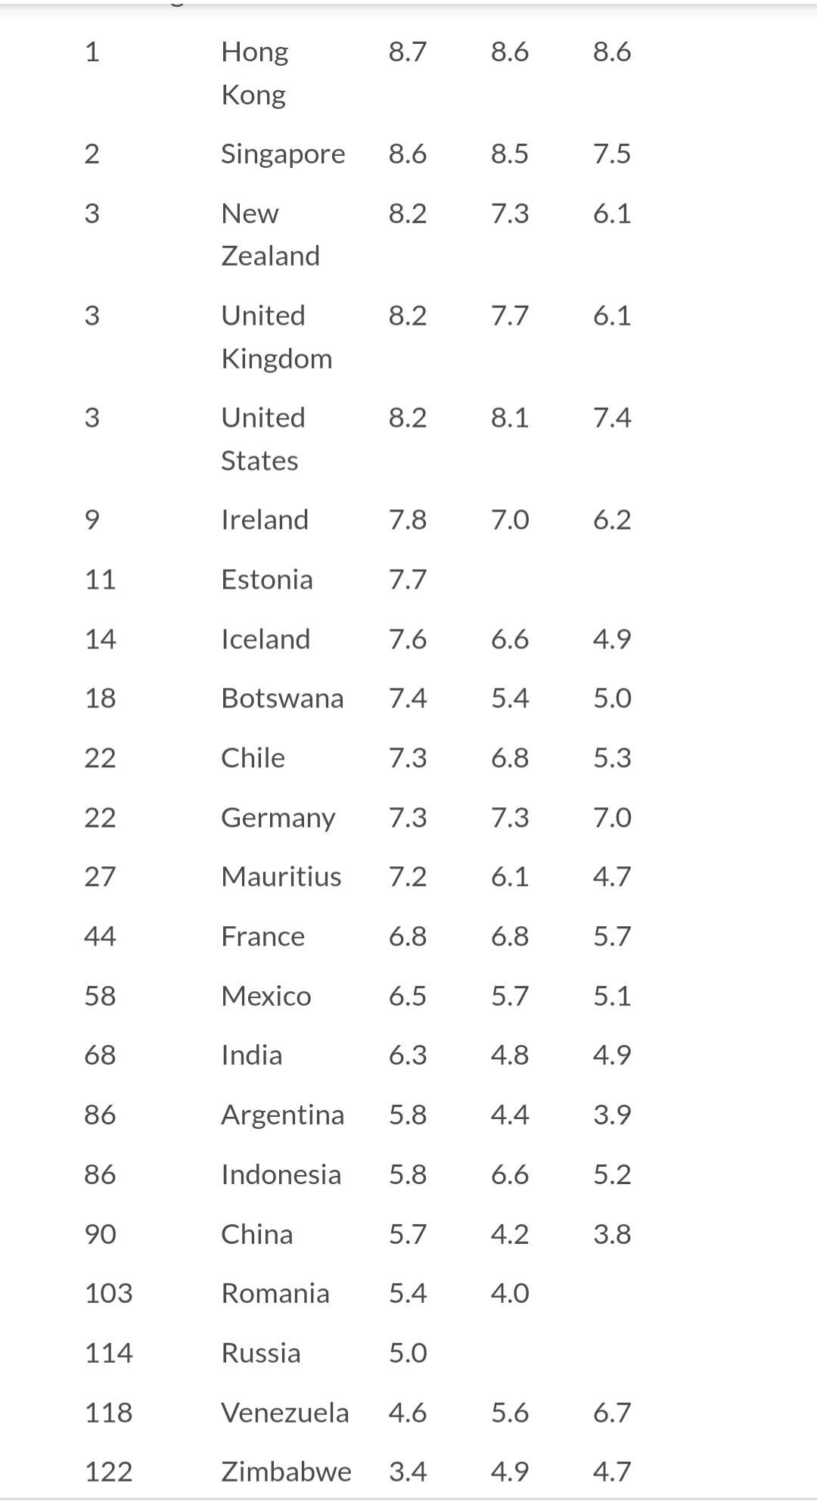
Various places of Economic Freedom

Slide 13
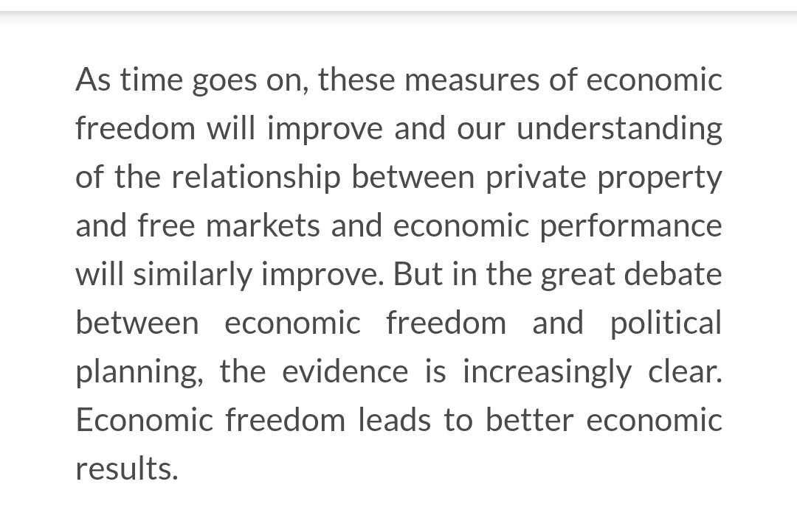
Conclusion

Slide 14
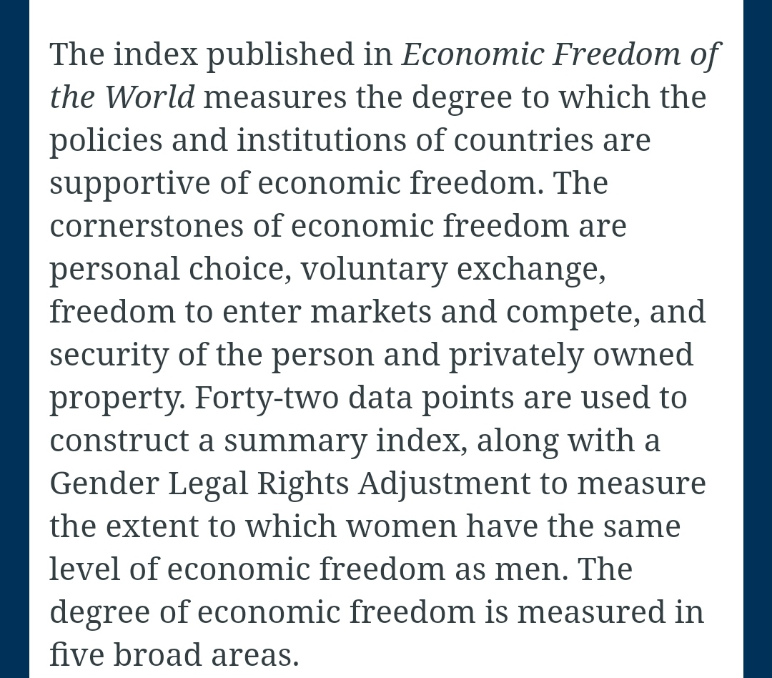
Future scope of Economic freedom

Slide 15
Finally

Slide 16
From our team members side
Thank you........

